Slide 1
Continuing SAGA of Paleobathymetry Development
Peter Olson, 14th March 2013
March 15th 2013

Slide 2
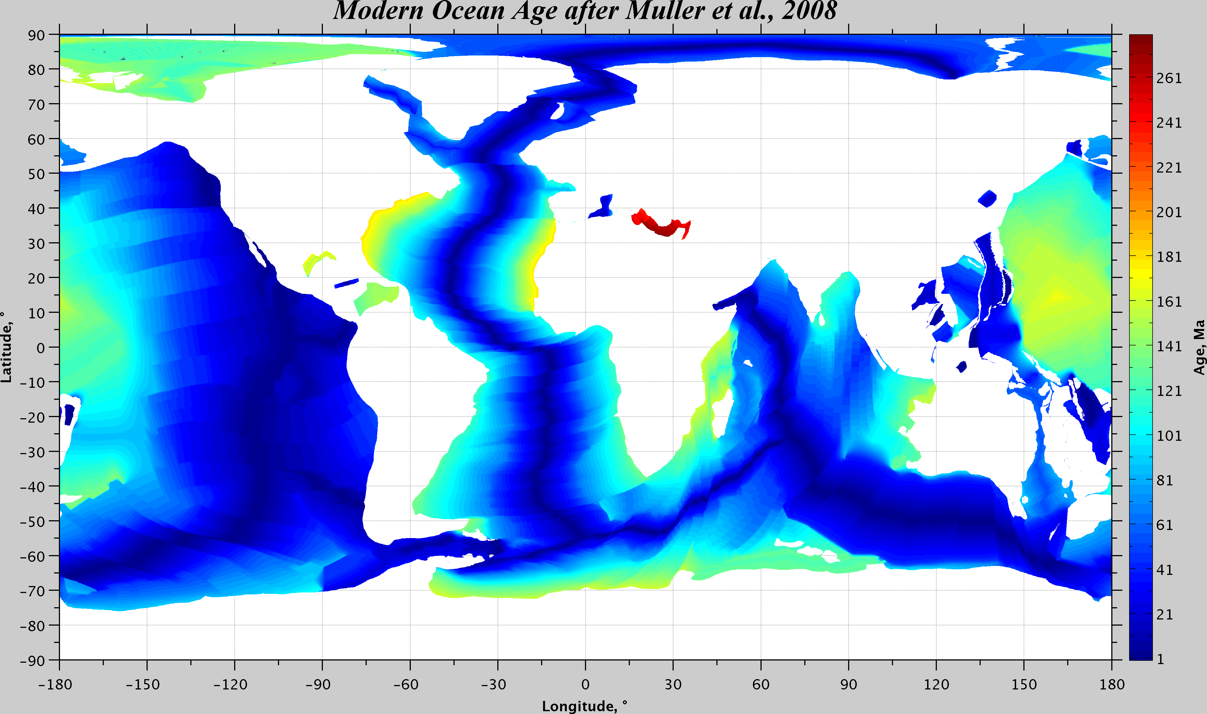

Slide 3
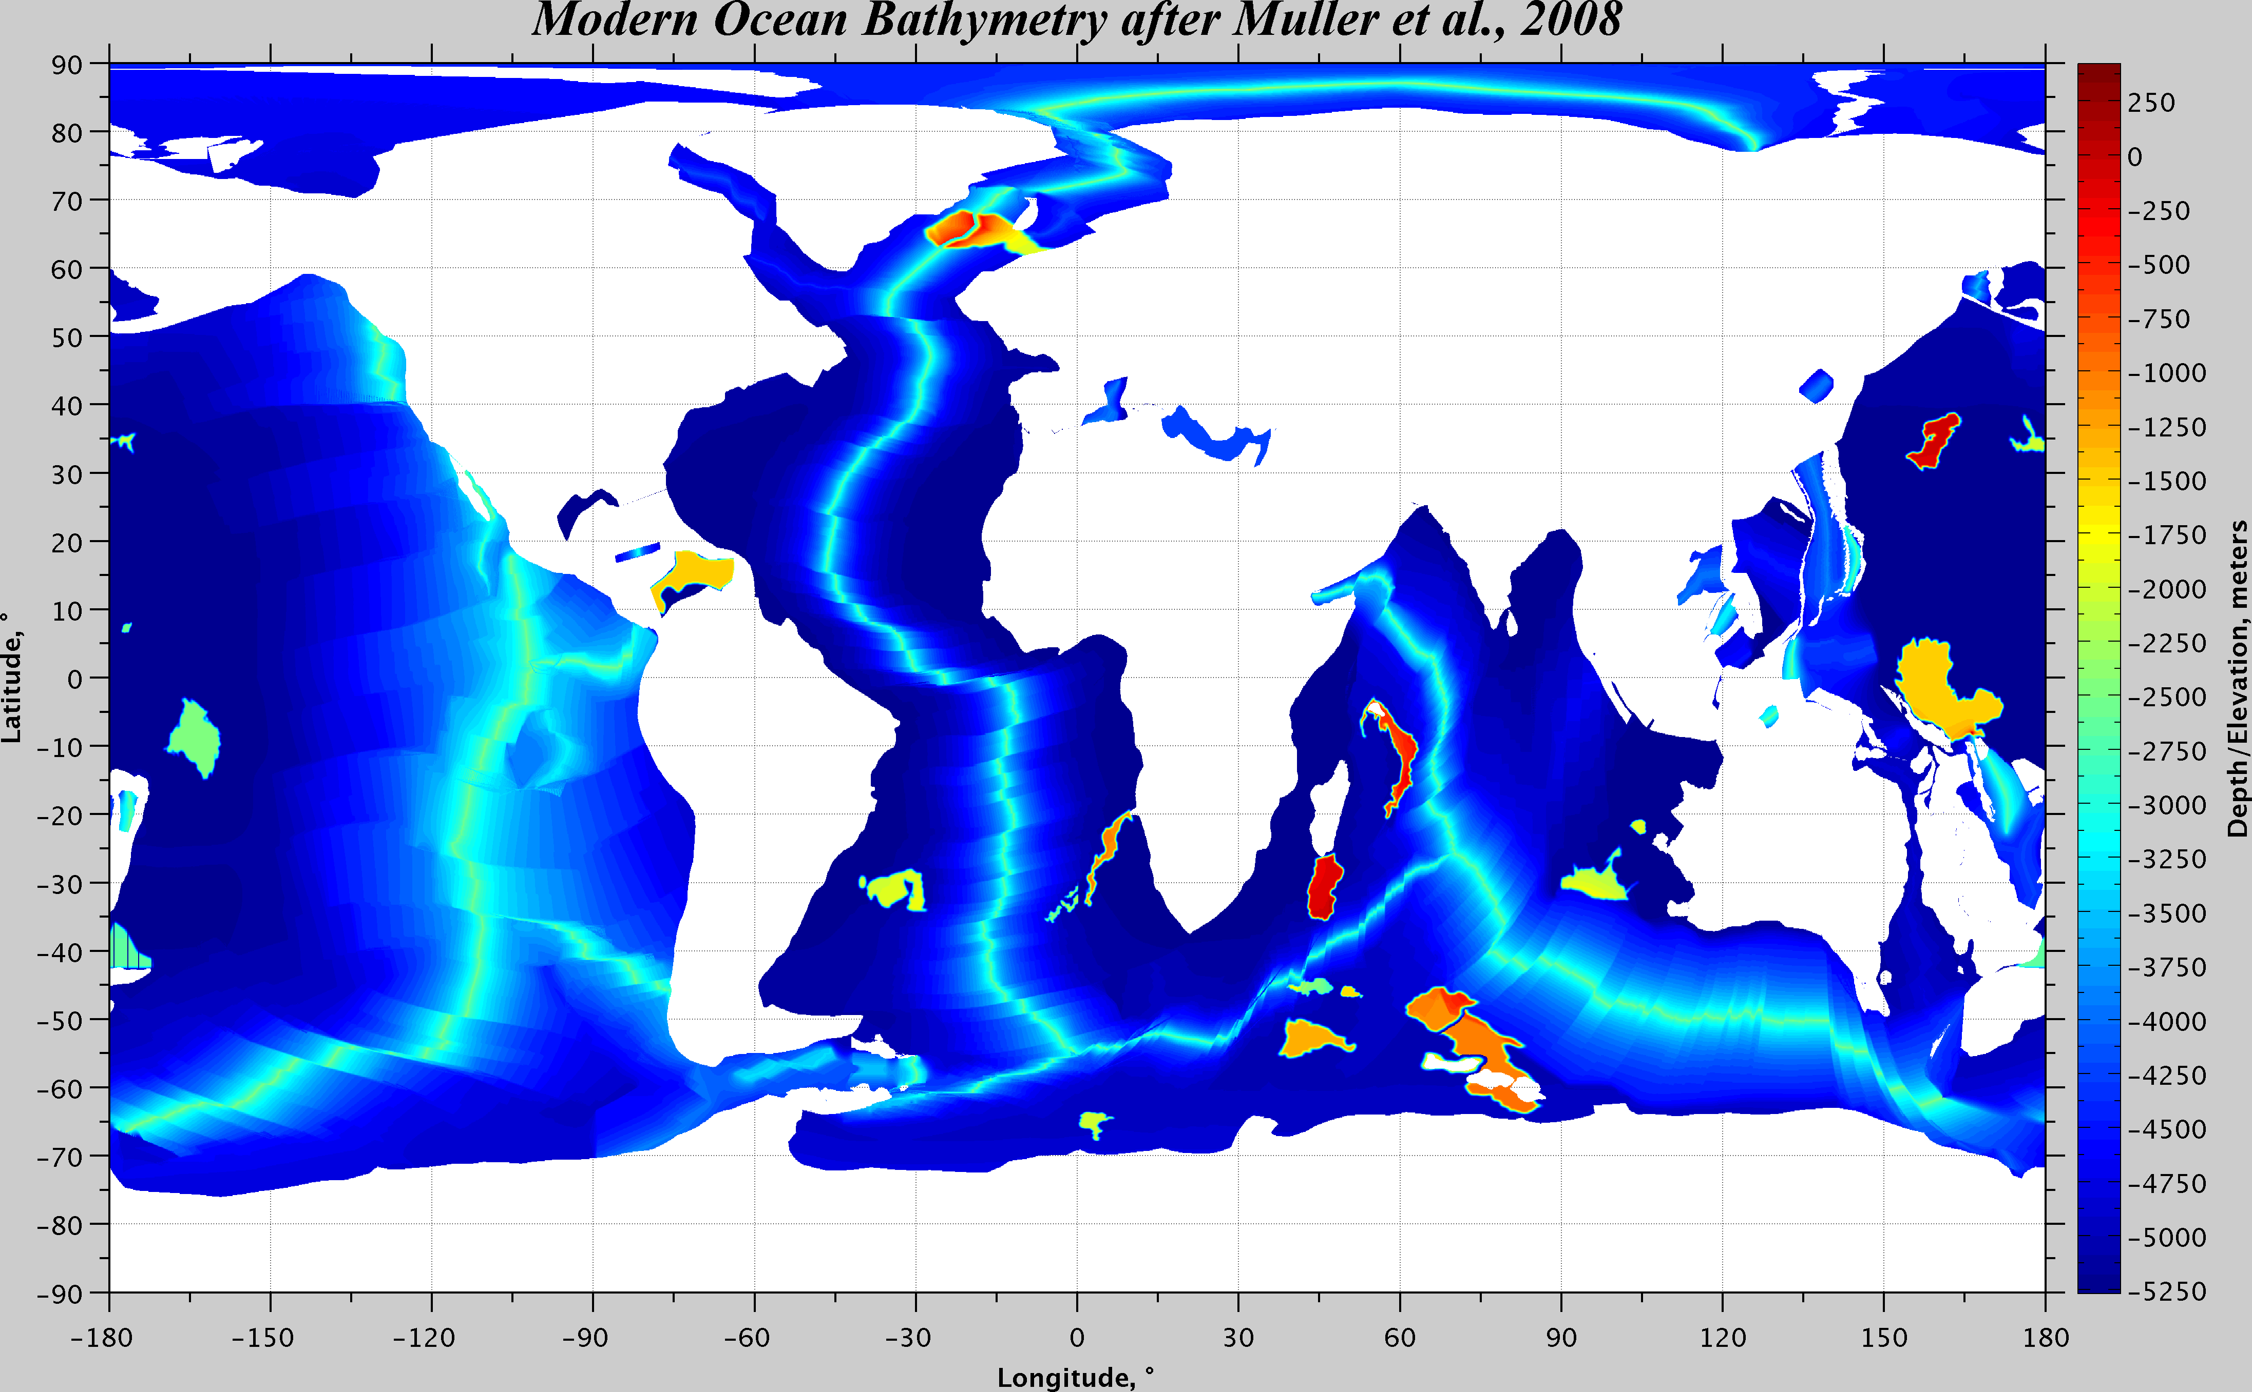

Slide 4
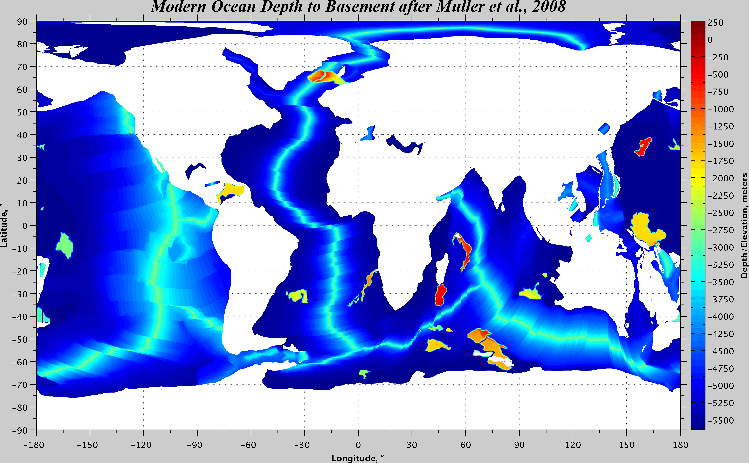

Slide 5
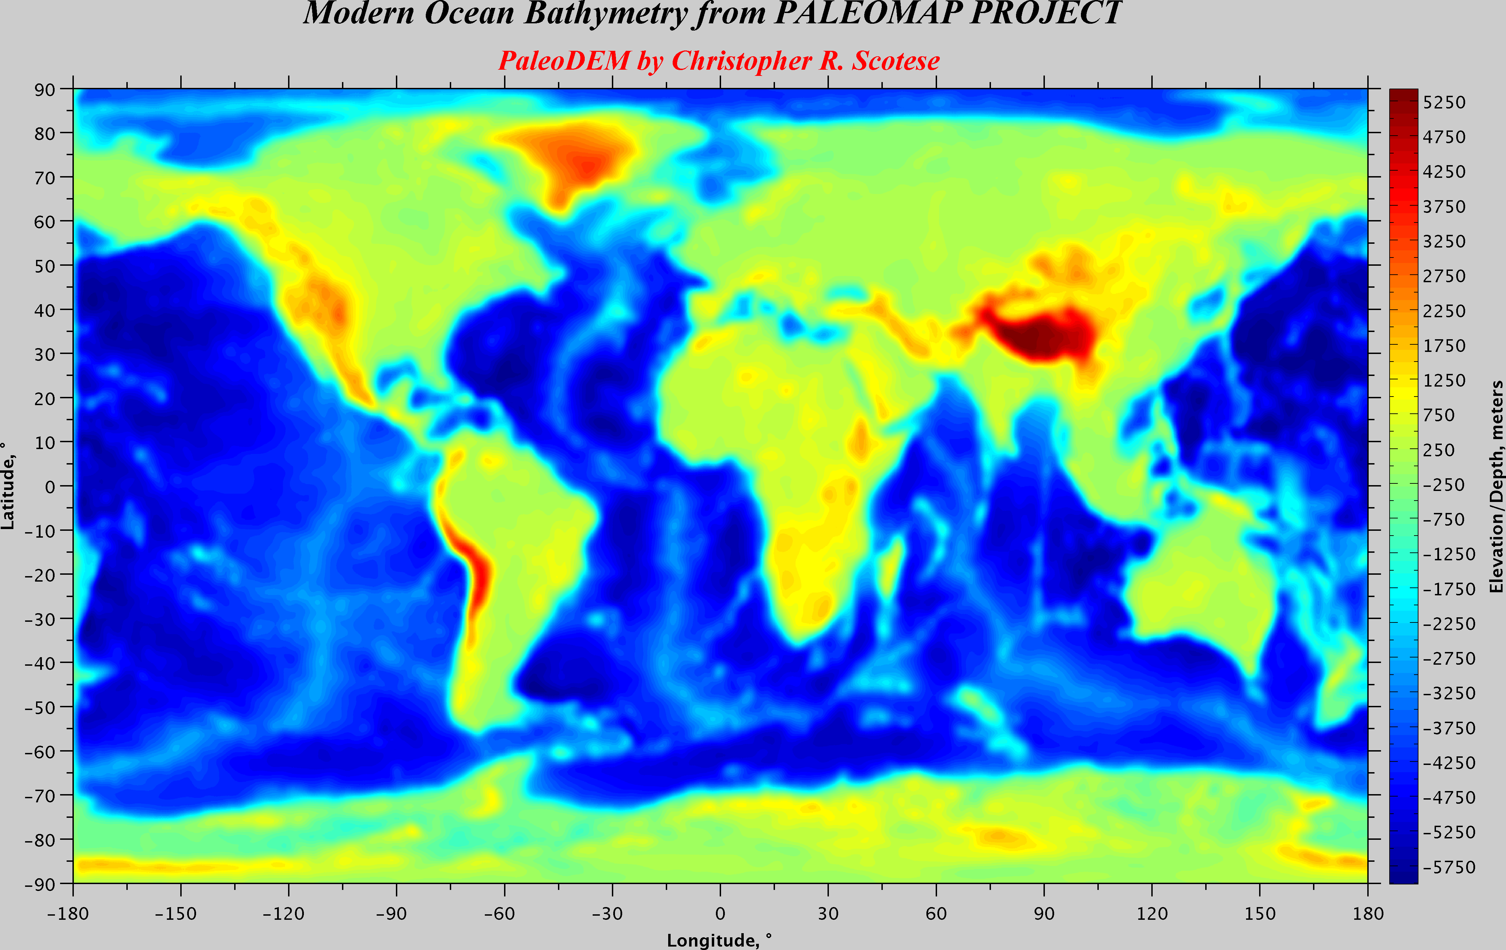

Slide 6
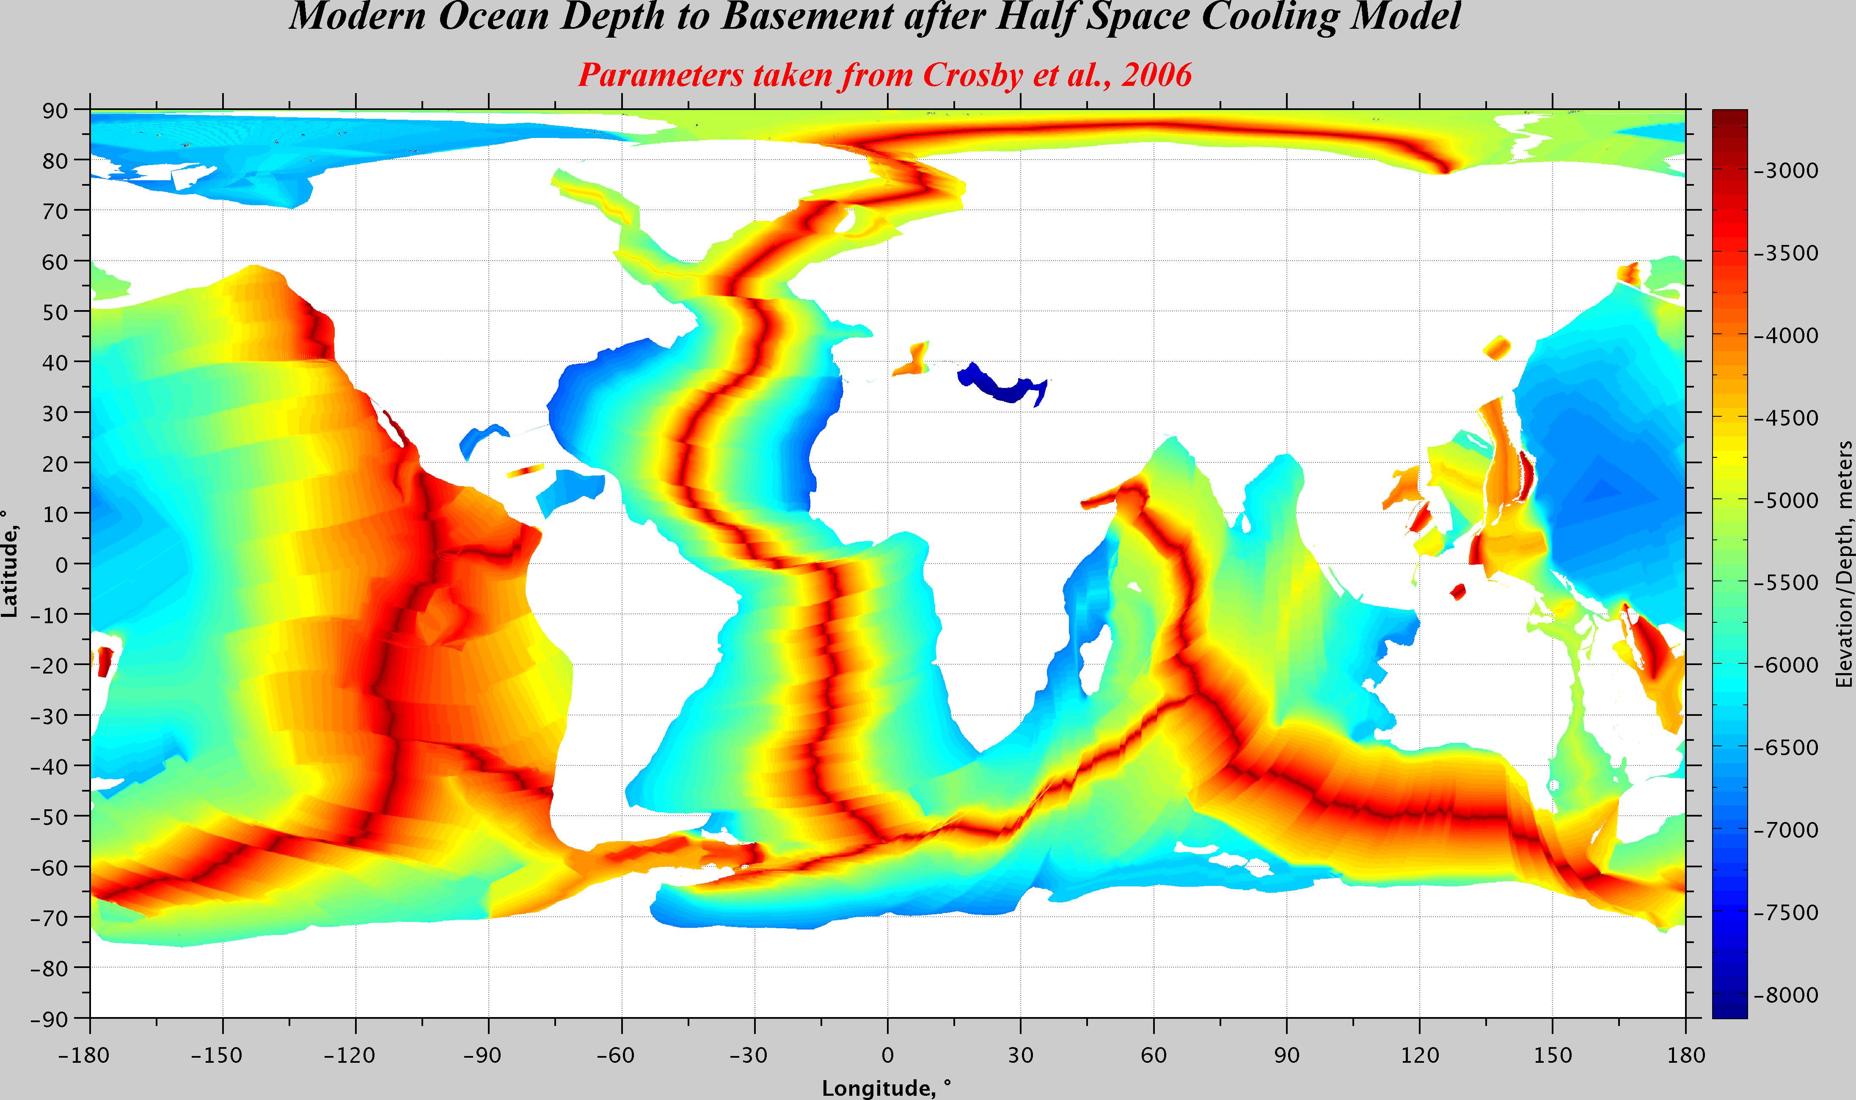

Slide 7
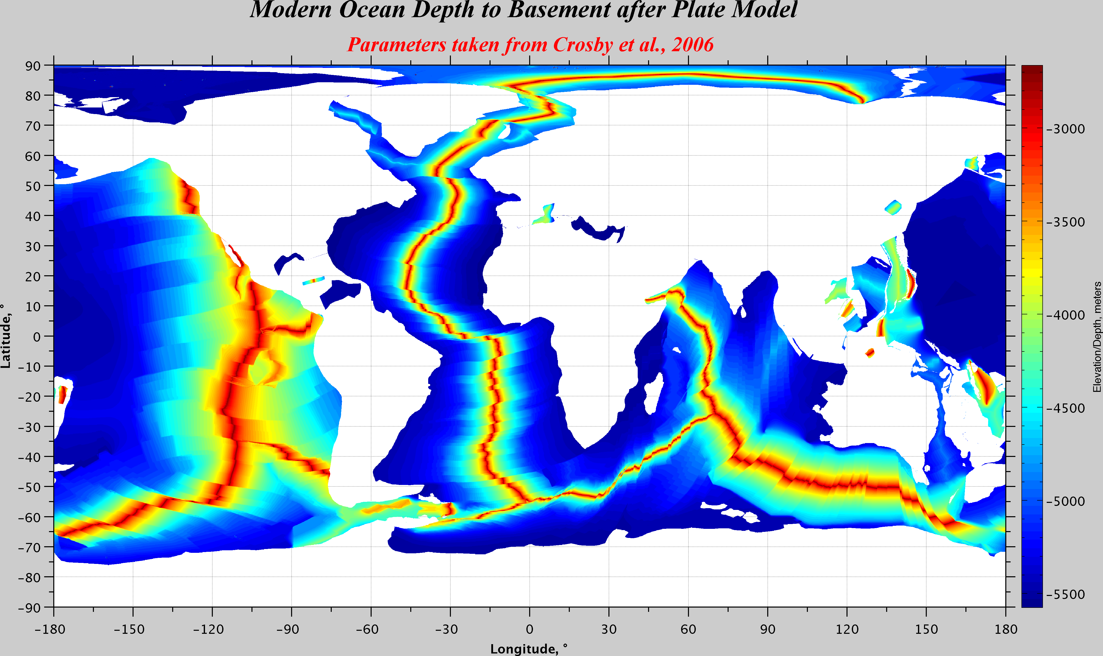

Slide 8
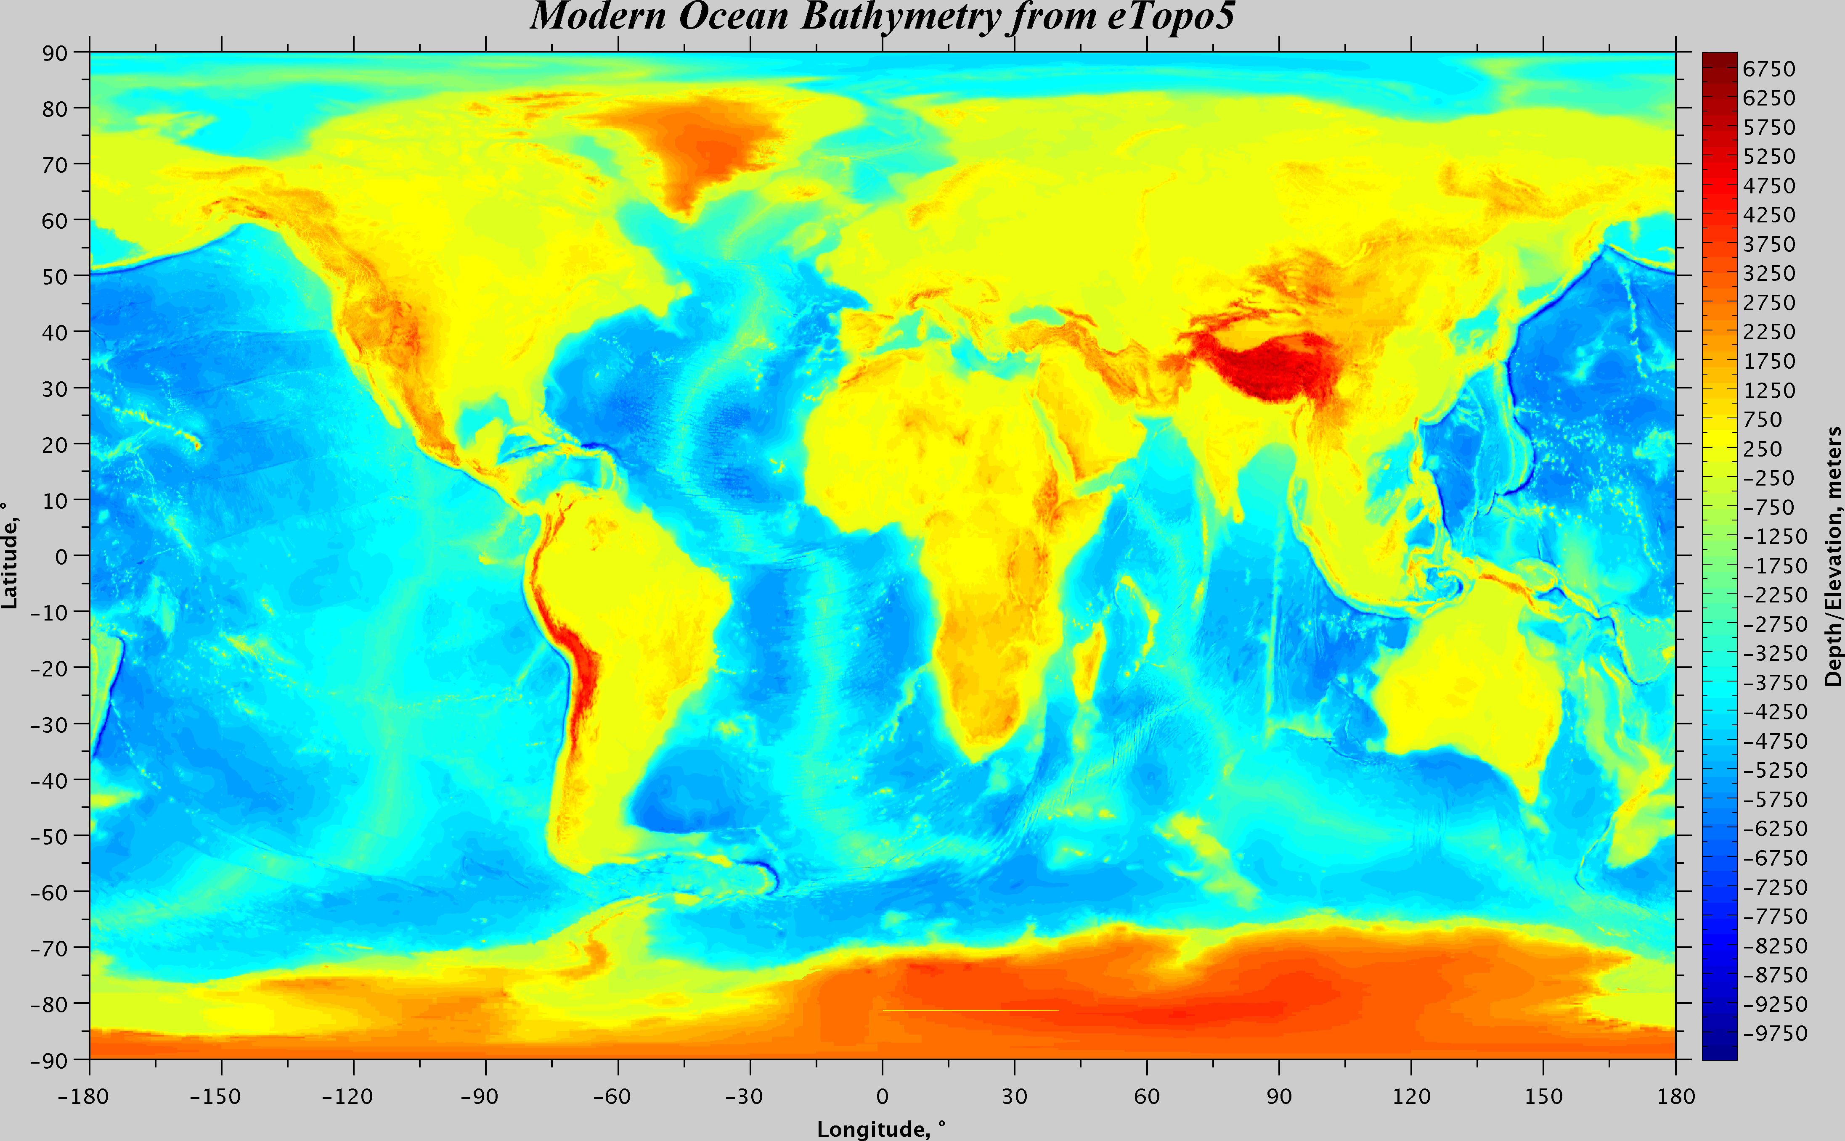

Slide 9
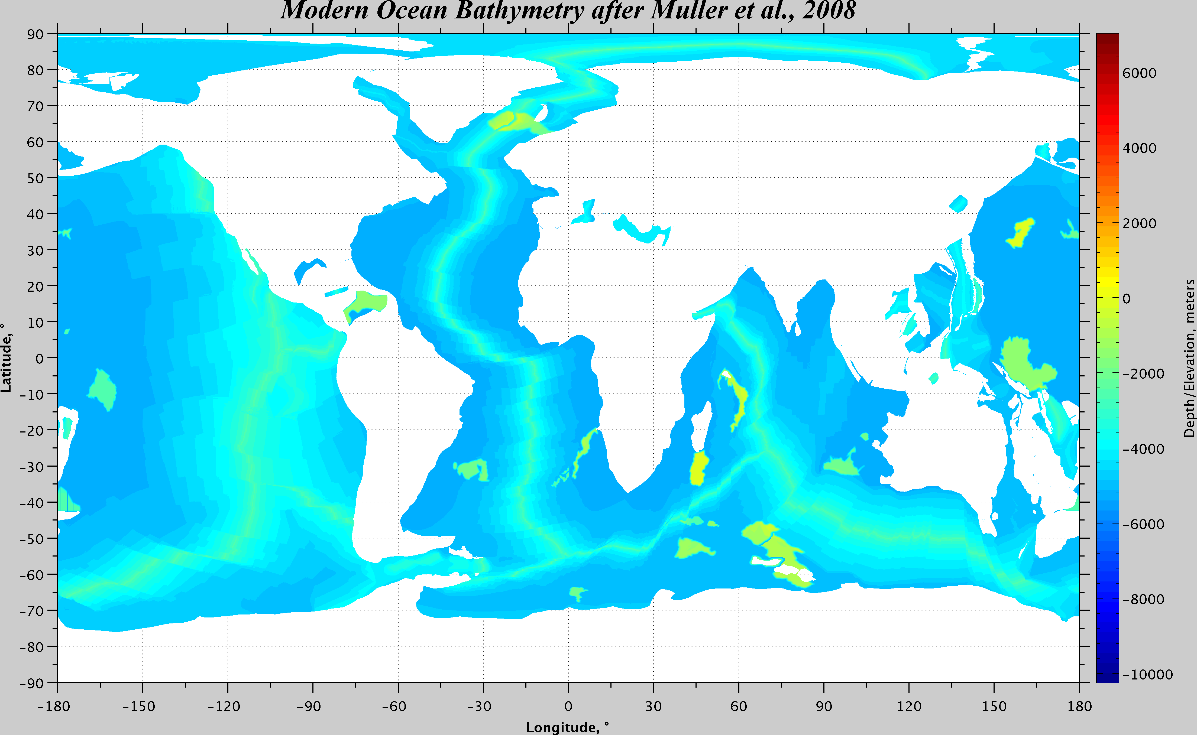

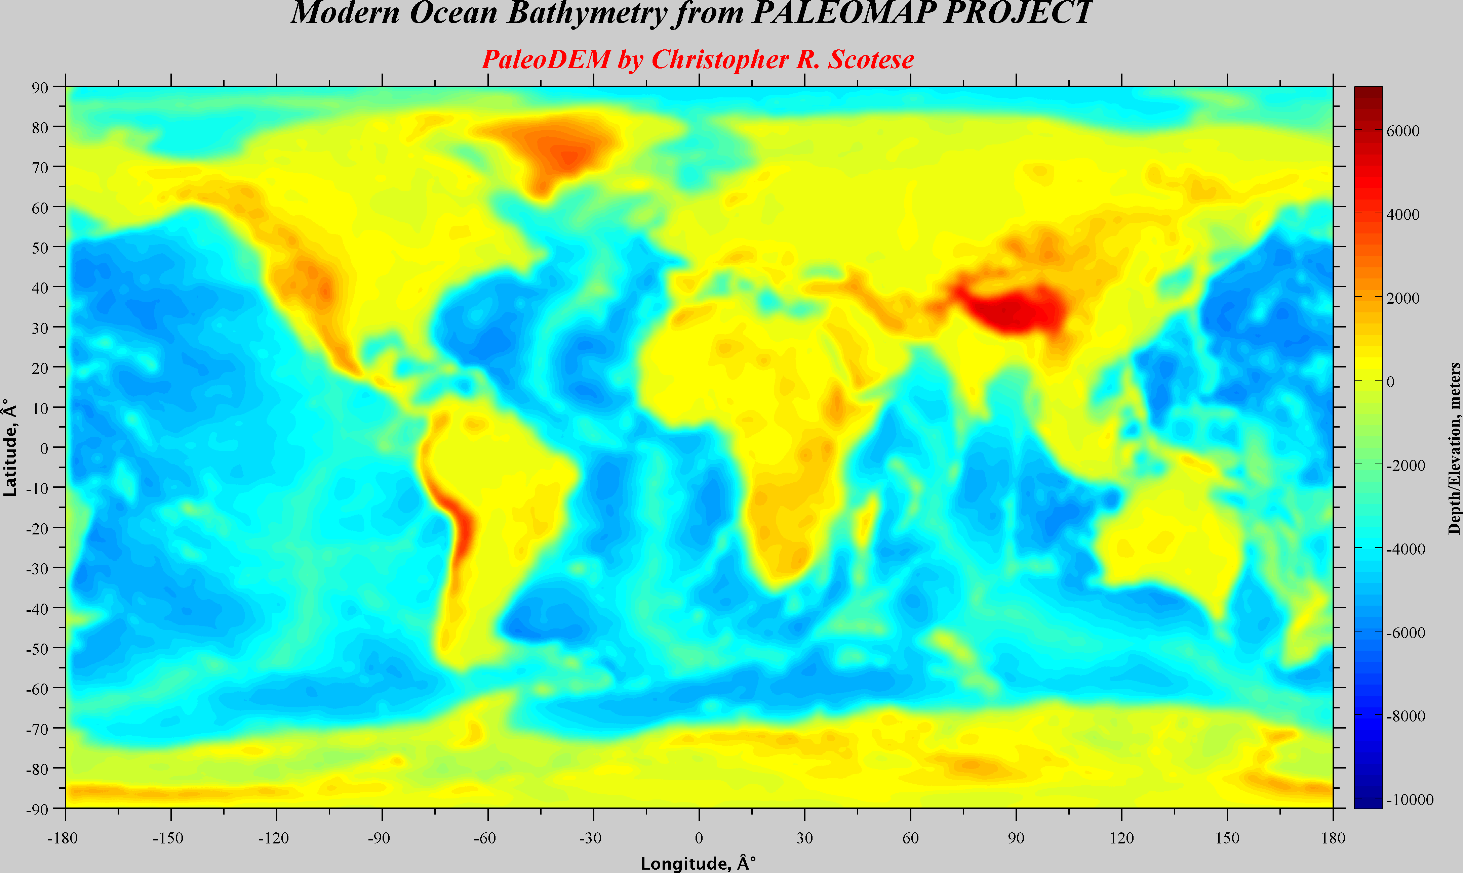
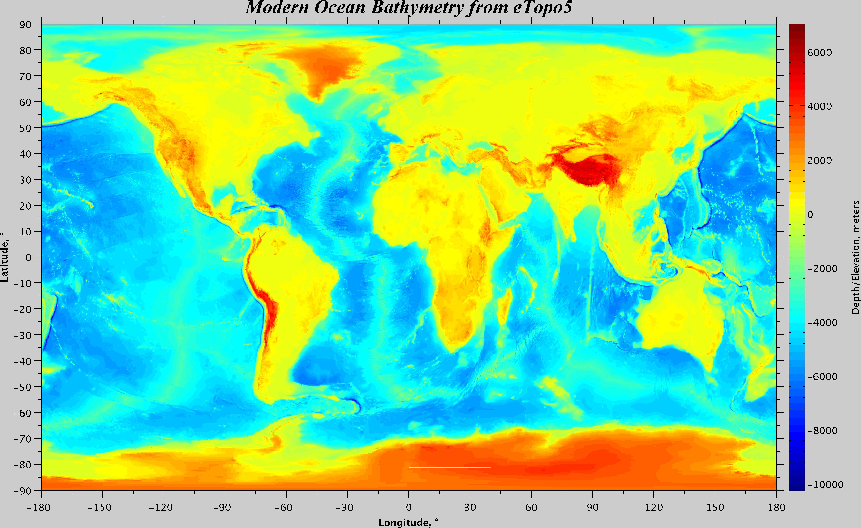

Slide 10
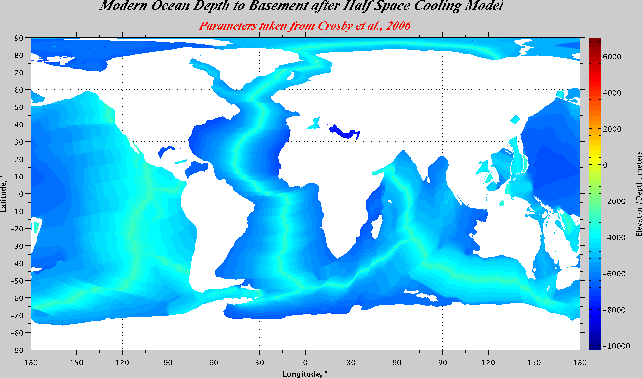
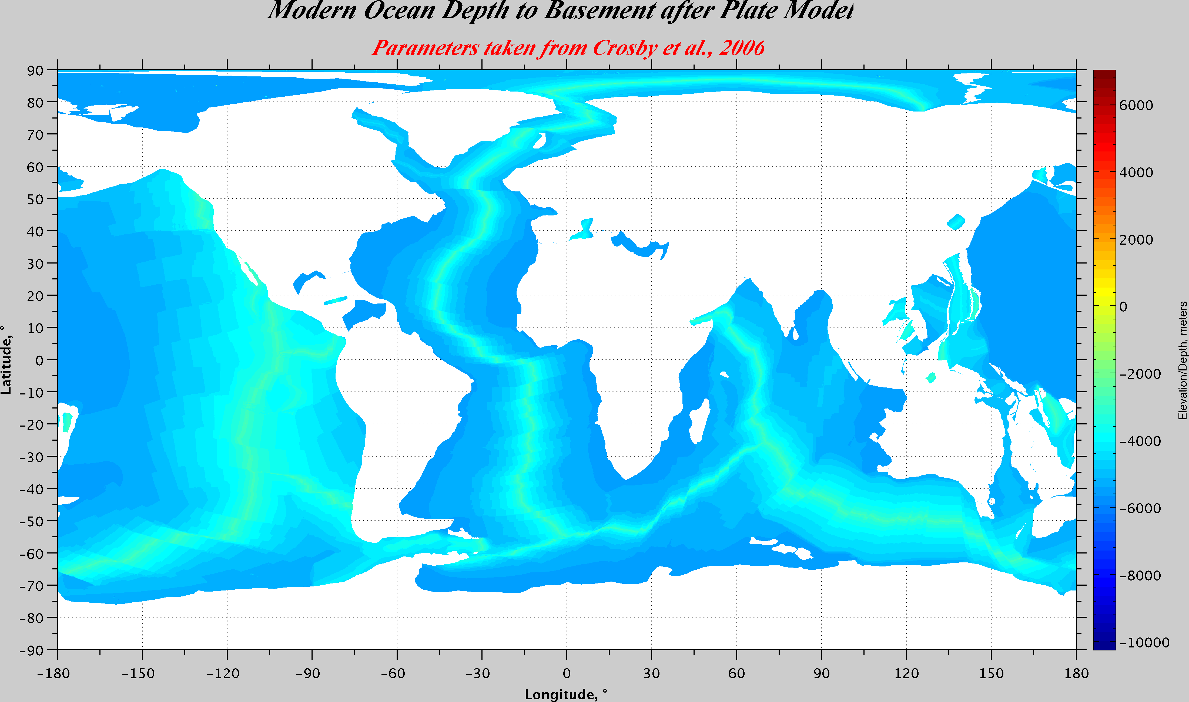

Slide 11
Stats
ColumnName | Maximum | Minimum | Mean | Median | Mode | Std_Dev
M_Age | 280 | 0 | 63.39079632 | 54.903152 | 0 | 44.74109779
Depth Fields Summary Statistics (meters)
ColumnName | Maximum | Minimum | Mean | Median | Mode | Std_Dev
M_D2B | -5649.9399 | 263.16162 | -4793.60727 | -5070.1802 | -5128.40 | 842.1513198
M_Bathy | -5266.9697 | 422.75269 | -4473.834907 | -4678.4653 | -4231.90 | 785.077775
PDEM000 | -6010.6 | 5425 | -2060.2 | -2401.6 | -5207.9 | 2284.1
ET5 | -10234 | 7010 | -1897.30 | -2508 | 0 | 2658.30
HSCM | -8152.748245 | -2639.796587 | -5067.918584 | -5080.999096 | -2639.80 | 992.4644586
PM | -5574.71 | -2662.69 | -4760.83 | -4952.82 | -2662.70 | 678.98
Diff ET5 & PM | 5496.50 | -5573.16 | -649.67 | -315.63 | 444.94 | 1078.26
Diff ET5 & M_D2B | 5347.64 | -5649.24 | -683.86 | -402.10 | -176.50 | 1065.42
Diff ET5 & M_Bathy | 5528.84 | -5265.71 | -364.11 | -129.07 | -41.00 | 986.55
Diff ET5 & PDEM | 6813.32 | -5109.02 | 240.47 | 54.81 | 65.73 | 810.03
CT* | 73.94 | 6.57 | 21.08 | 15.91 | 6.57 | 14.35
* | in Km
ColumnName | Maximum | Minimum | Mean | Median | Mode | Std_Dev
SedThick | 18171.00 | 0.00 | 382.77 | 32.00 | 0.00 | 1016.76
Muller Sediment | 1417.75 | 96.23 | 319.77 | 270.98 | 1417.75 | 187.75

Slide 13
What Controls Sedimentation
The distribution of sediments in the oceans is controlled by five primary factors:
Age of the underlying crust. (Divins, 2003)
Tectonic history of the ocean crust. (Divins, 2003)
Structural trends in basement. (Divins, 2003)
Nature and location of sediment source, and (Divins, 2003)
Nature of the sedimentary processes delivering sediments to depo-centers. (Divins, 2003)
6. For geological past
- Productivity
- Paleo-Latitude (Carbonates & Reefs)
- Sea level (Fluctuation of CCD)

Slide 14
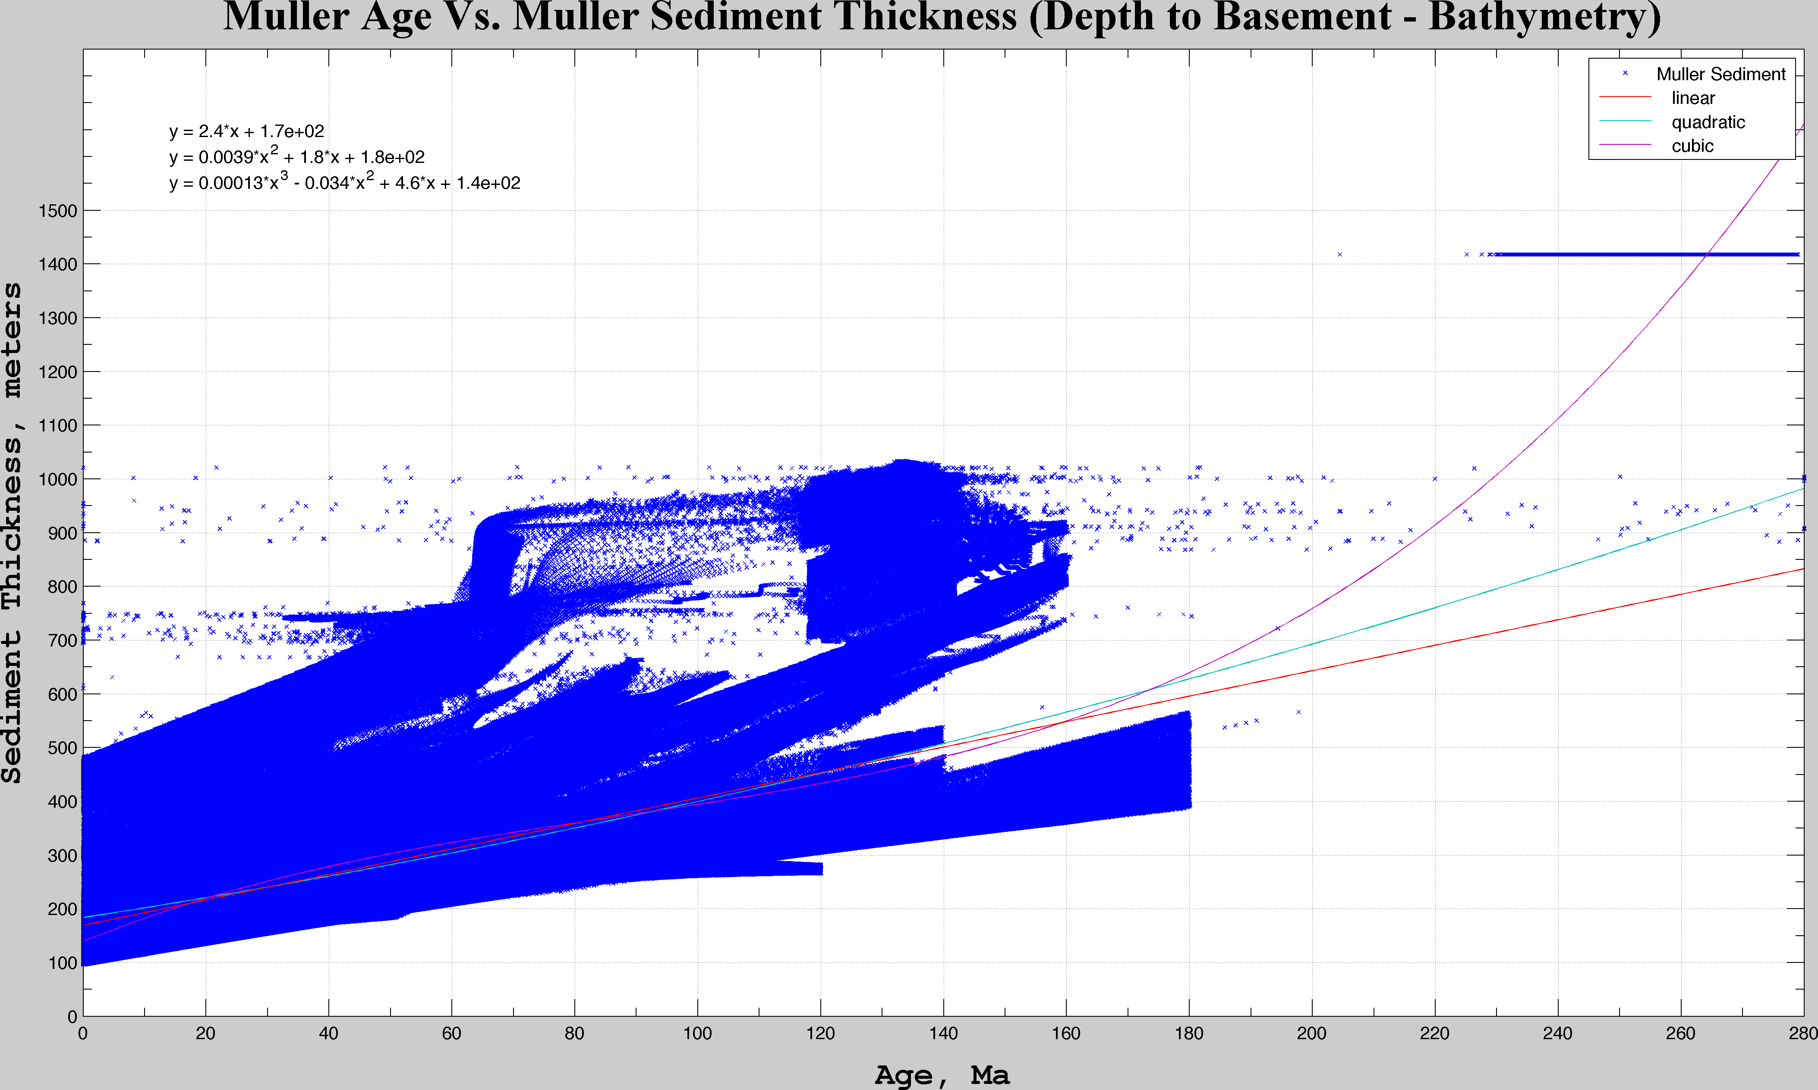
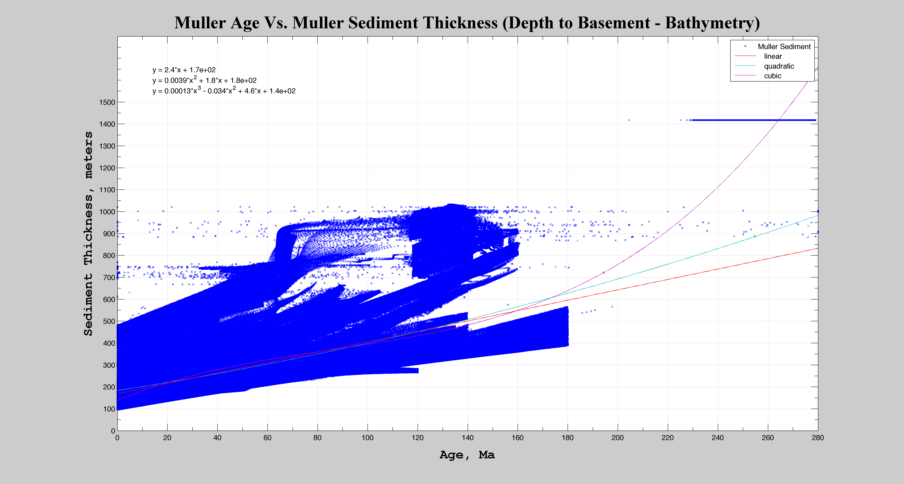

Slide 15
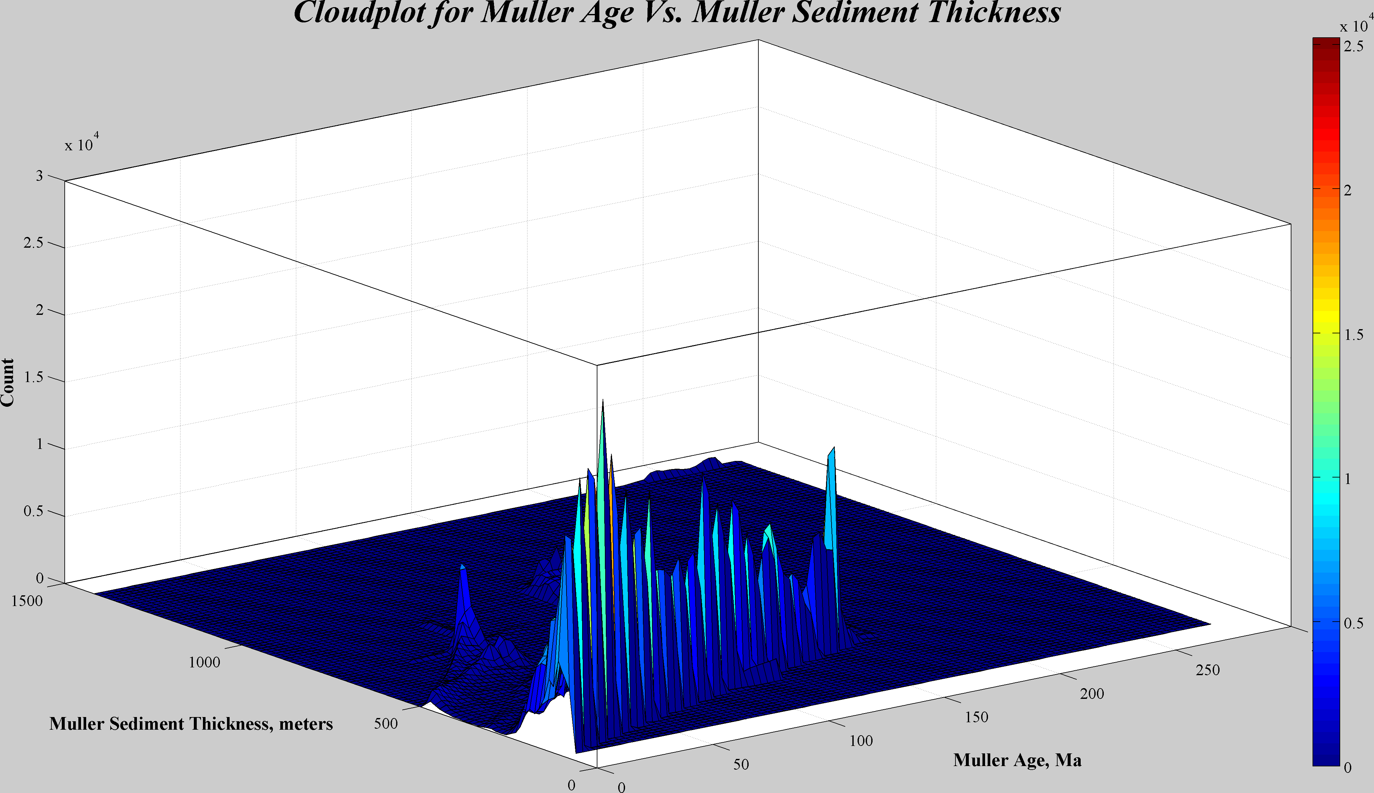
Linearly spaced groups, n=100

Slide 16
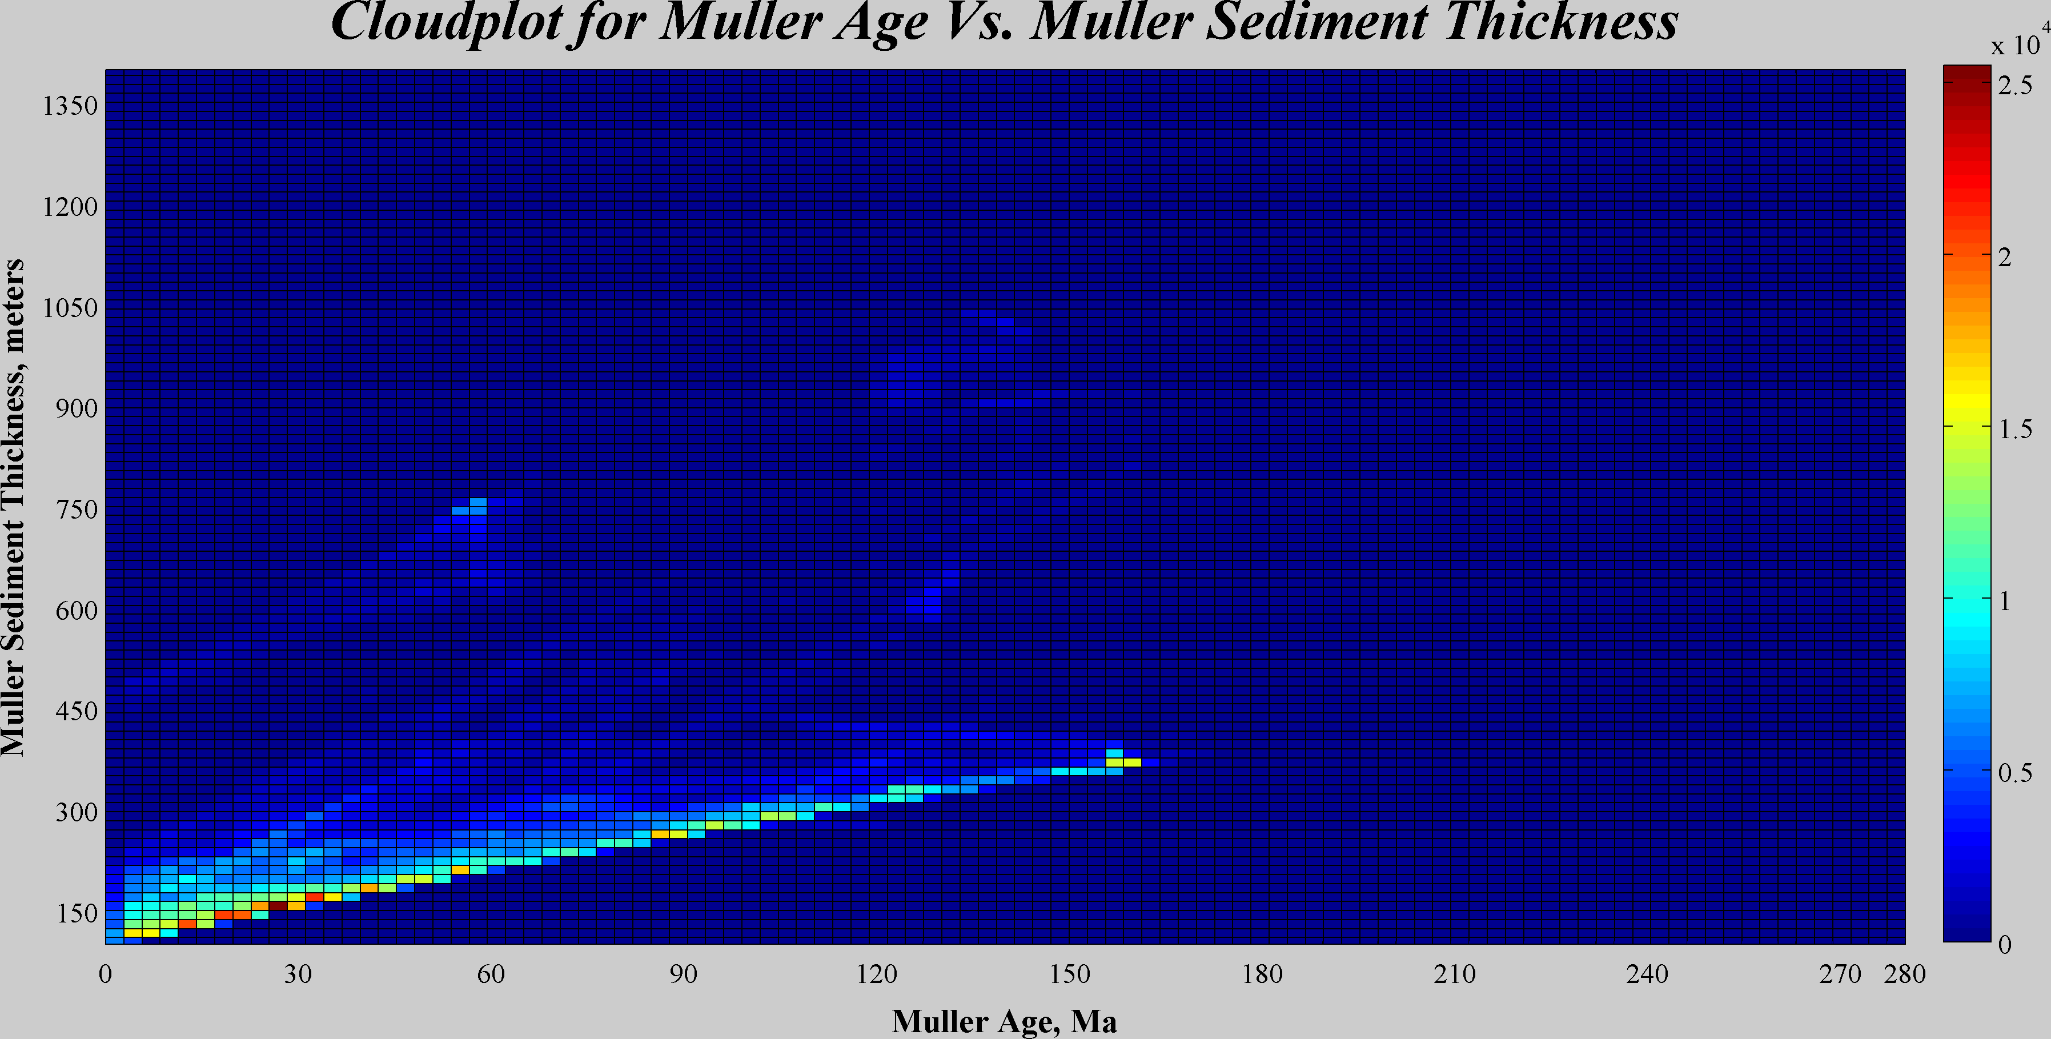
Linearly spaced groups, n=100

Slide 17
What is Muller Sediment
> • What is the difference between depth and bathymetry columns? ………. > We assumed depth to be top of the oceanic crust,i.e., water depth and sediment depth combined together, where as bathymetry is the simple representation of water depth. Yes - <<<<<<This is Muller’s respone to the answer Christian Haine wrote above. ftp://ftp.earthbyte.org/earthbyte/agegrid/Palaeo/2008/Data/README.txt

Slide 18
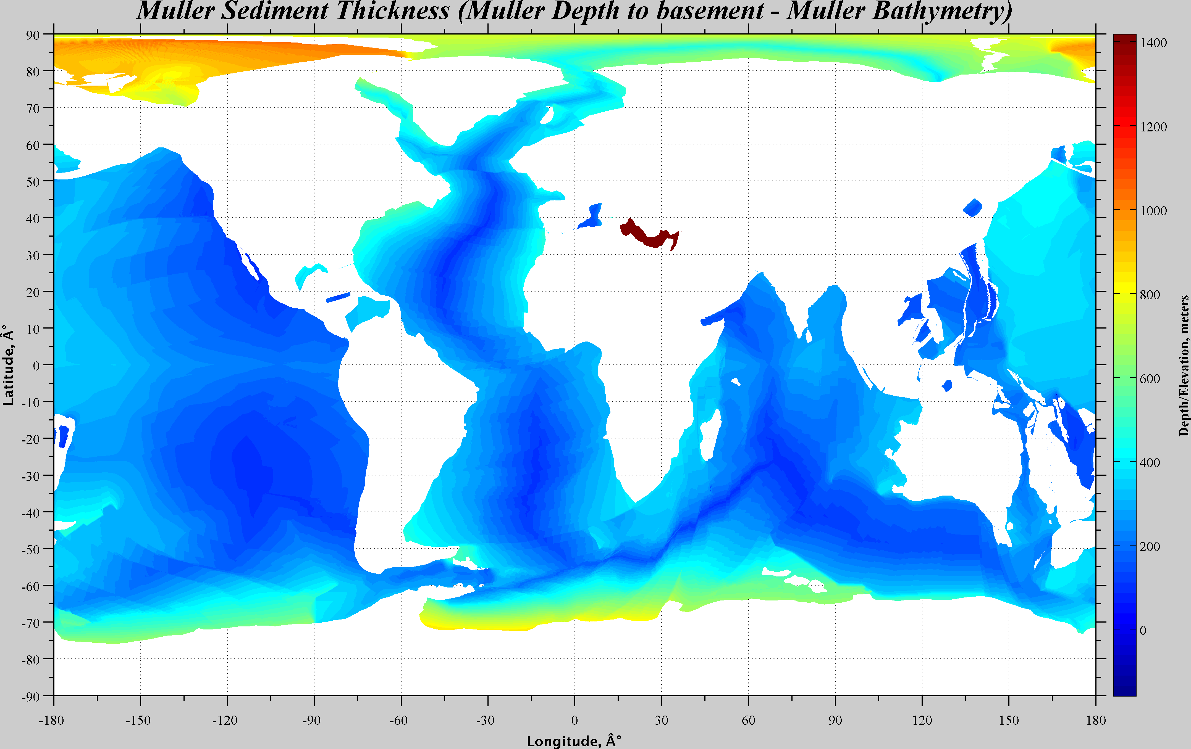

Slide 19
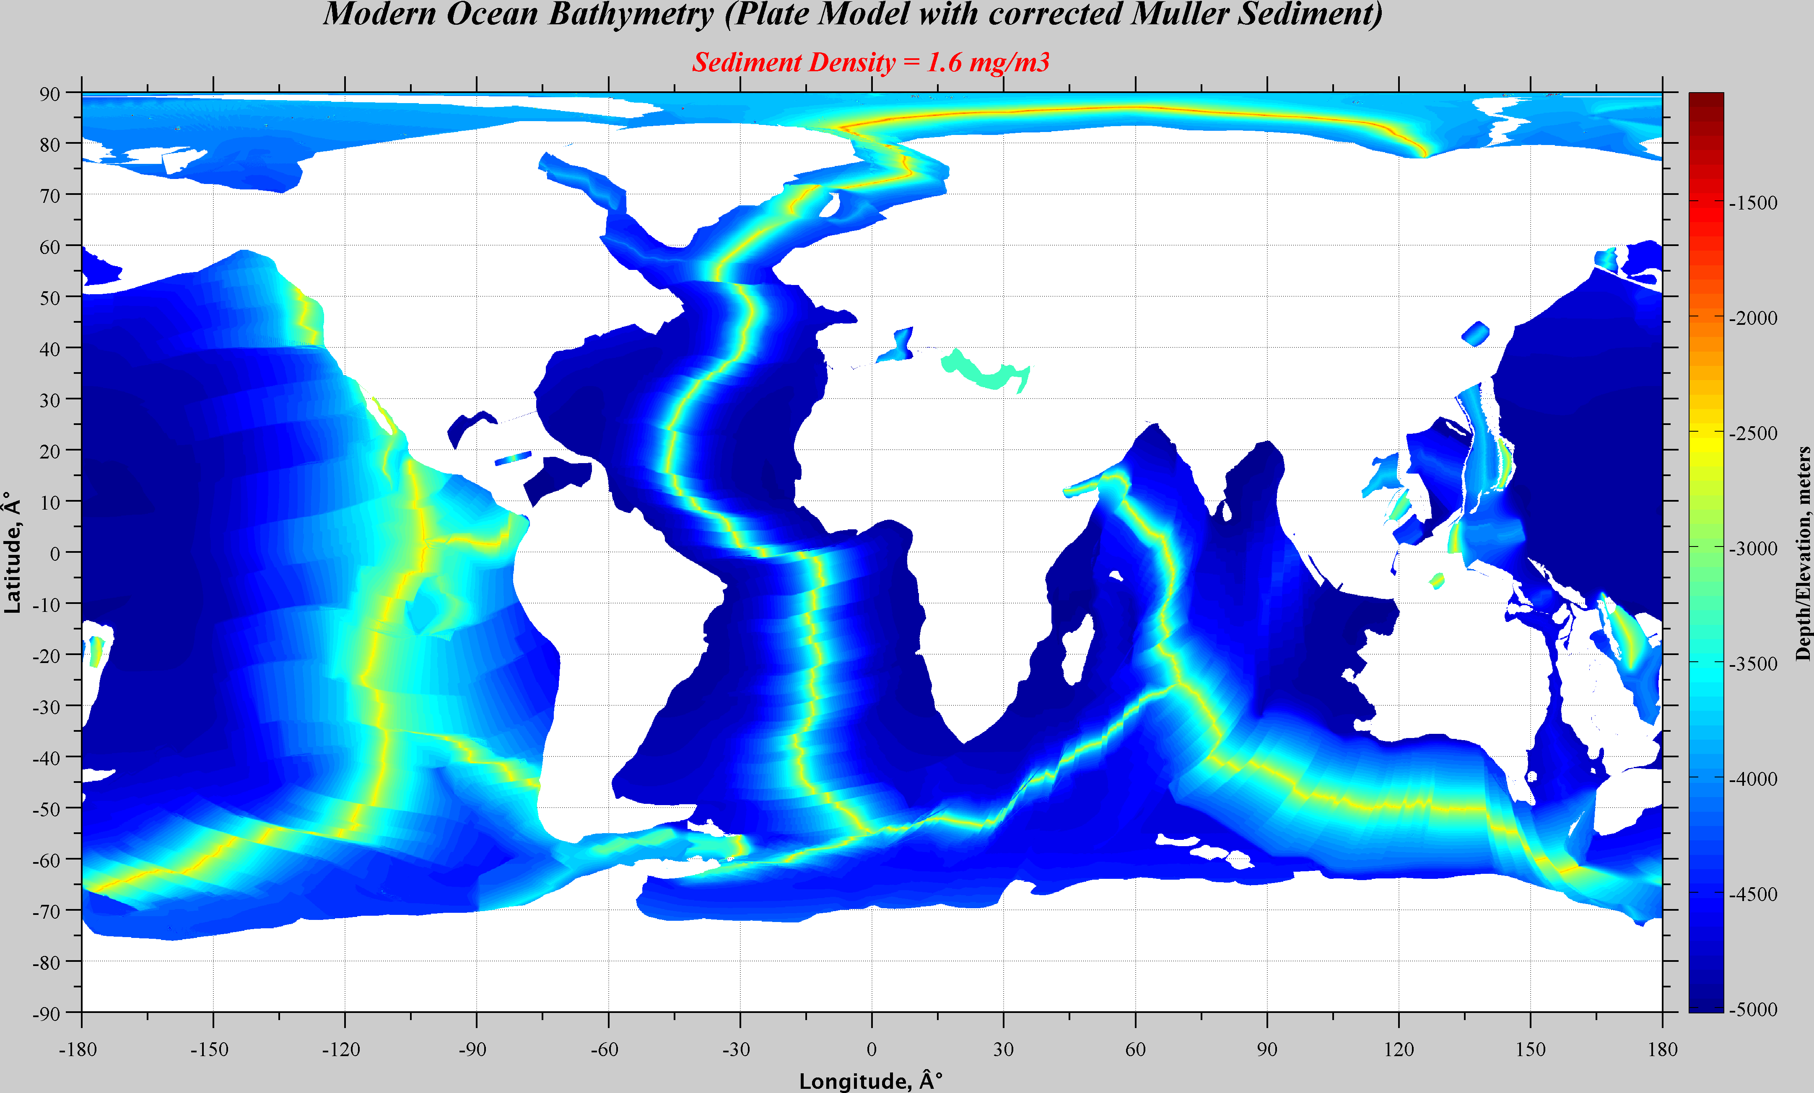

Slide 20
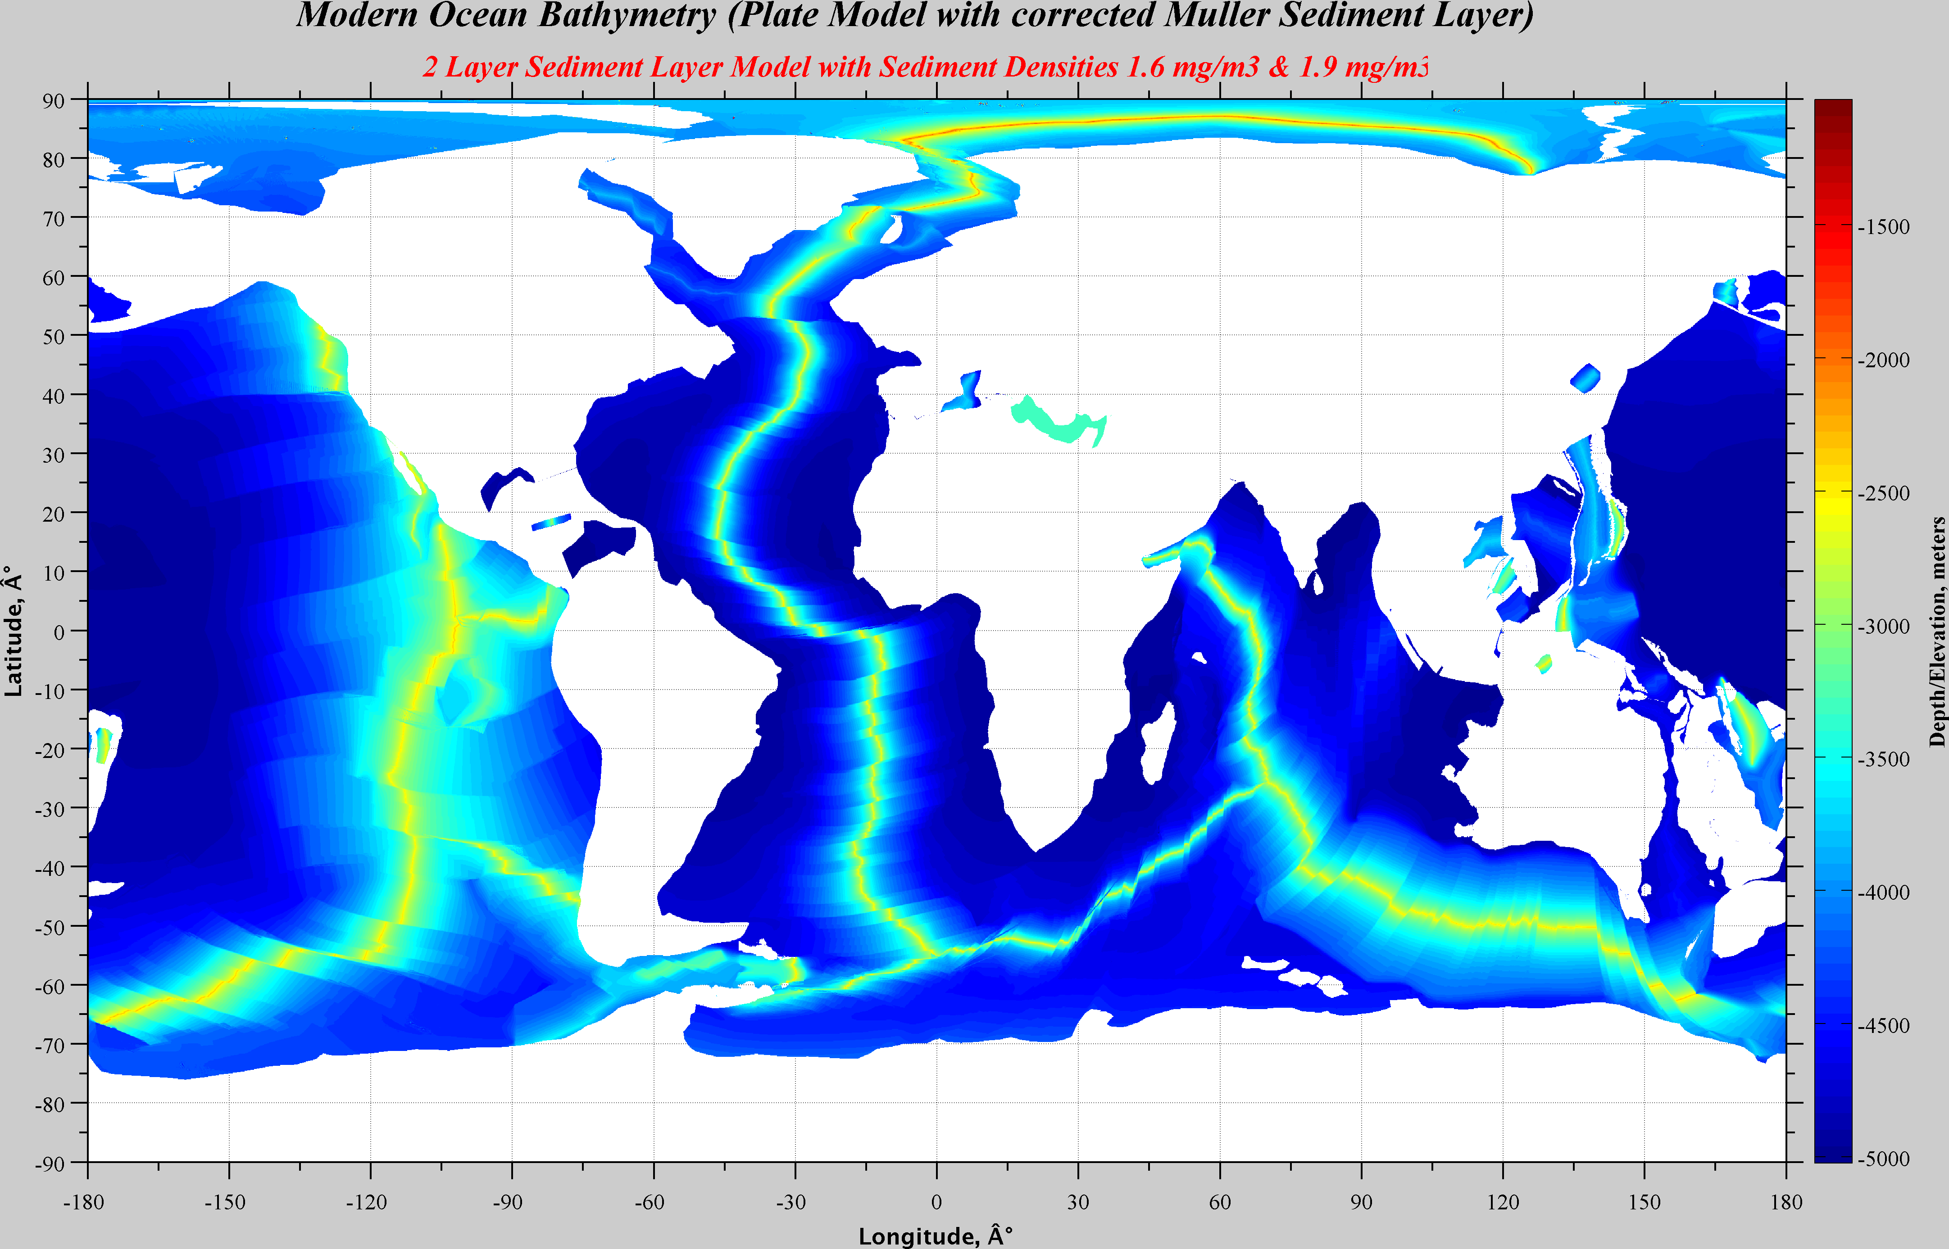

Slide 21
What Controls Sedimentation
The distribution of sediments in the oceans is controlled by five primary factors:
Age of the underlying crust. (Divins, 2003)
Tectonic history of the ocean crust. (Divins, 2003)
Structural trends in basement. (Divins, 2003)
Nature and location of sediment source, and (Divins, 2003)
Nature of the sedimentary processes delivering sediments to depo-centers. (Divins, 2003)
6. For geological past
- Productivity
- Paleo-Latitude (Carbonates & Reefs)
- Sea level (Fluctuation of CCD)

Slide 22
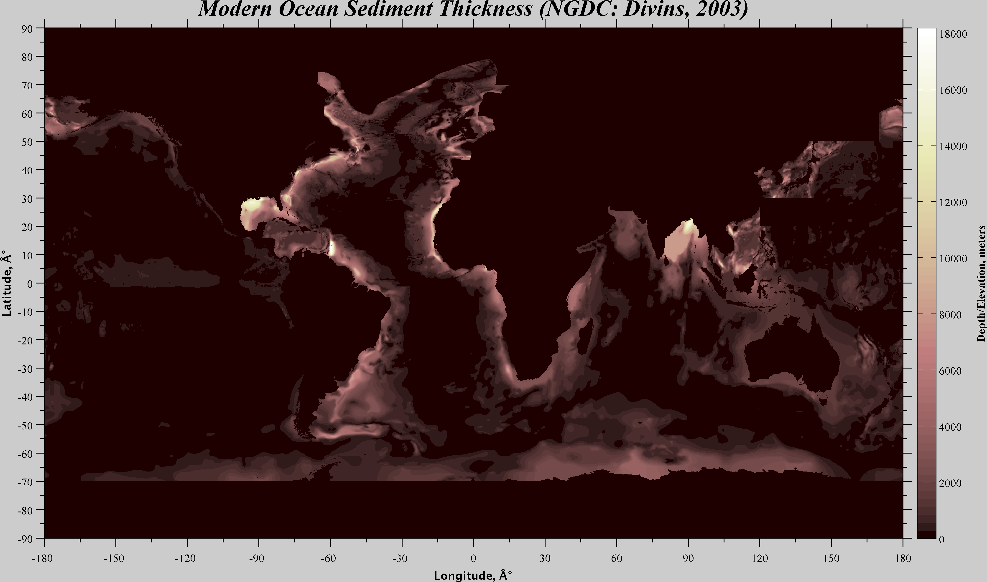
The data values are in meters and represent the depth to acoustic basement.
It should be noted that acoustic basement may not actually represent the base of the sediments.
These data are intended to provide a minimum value for the thickness of the sediment in a particular geographic region.

Slide 23
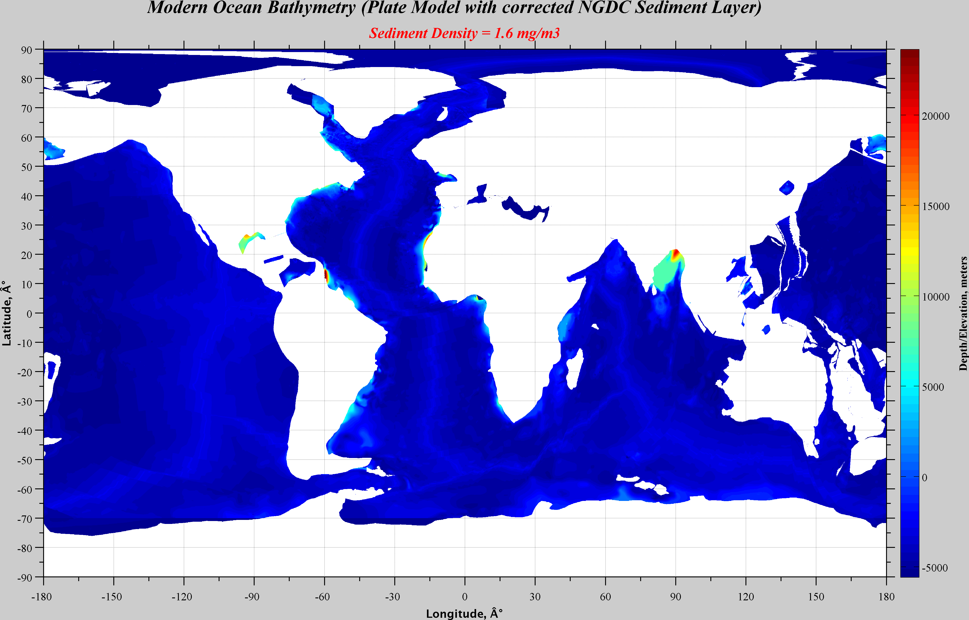

Slide 24
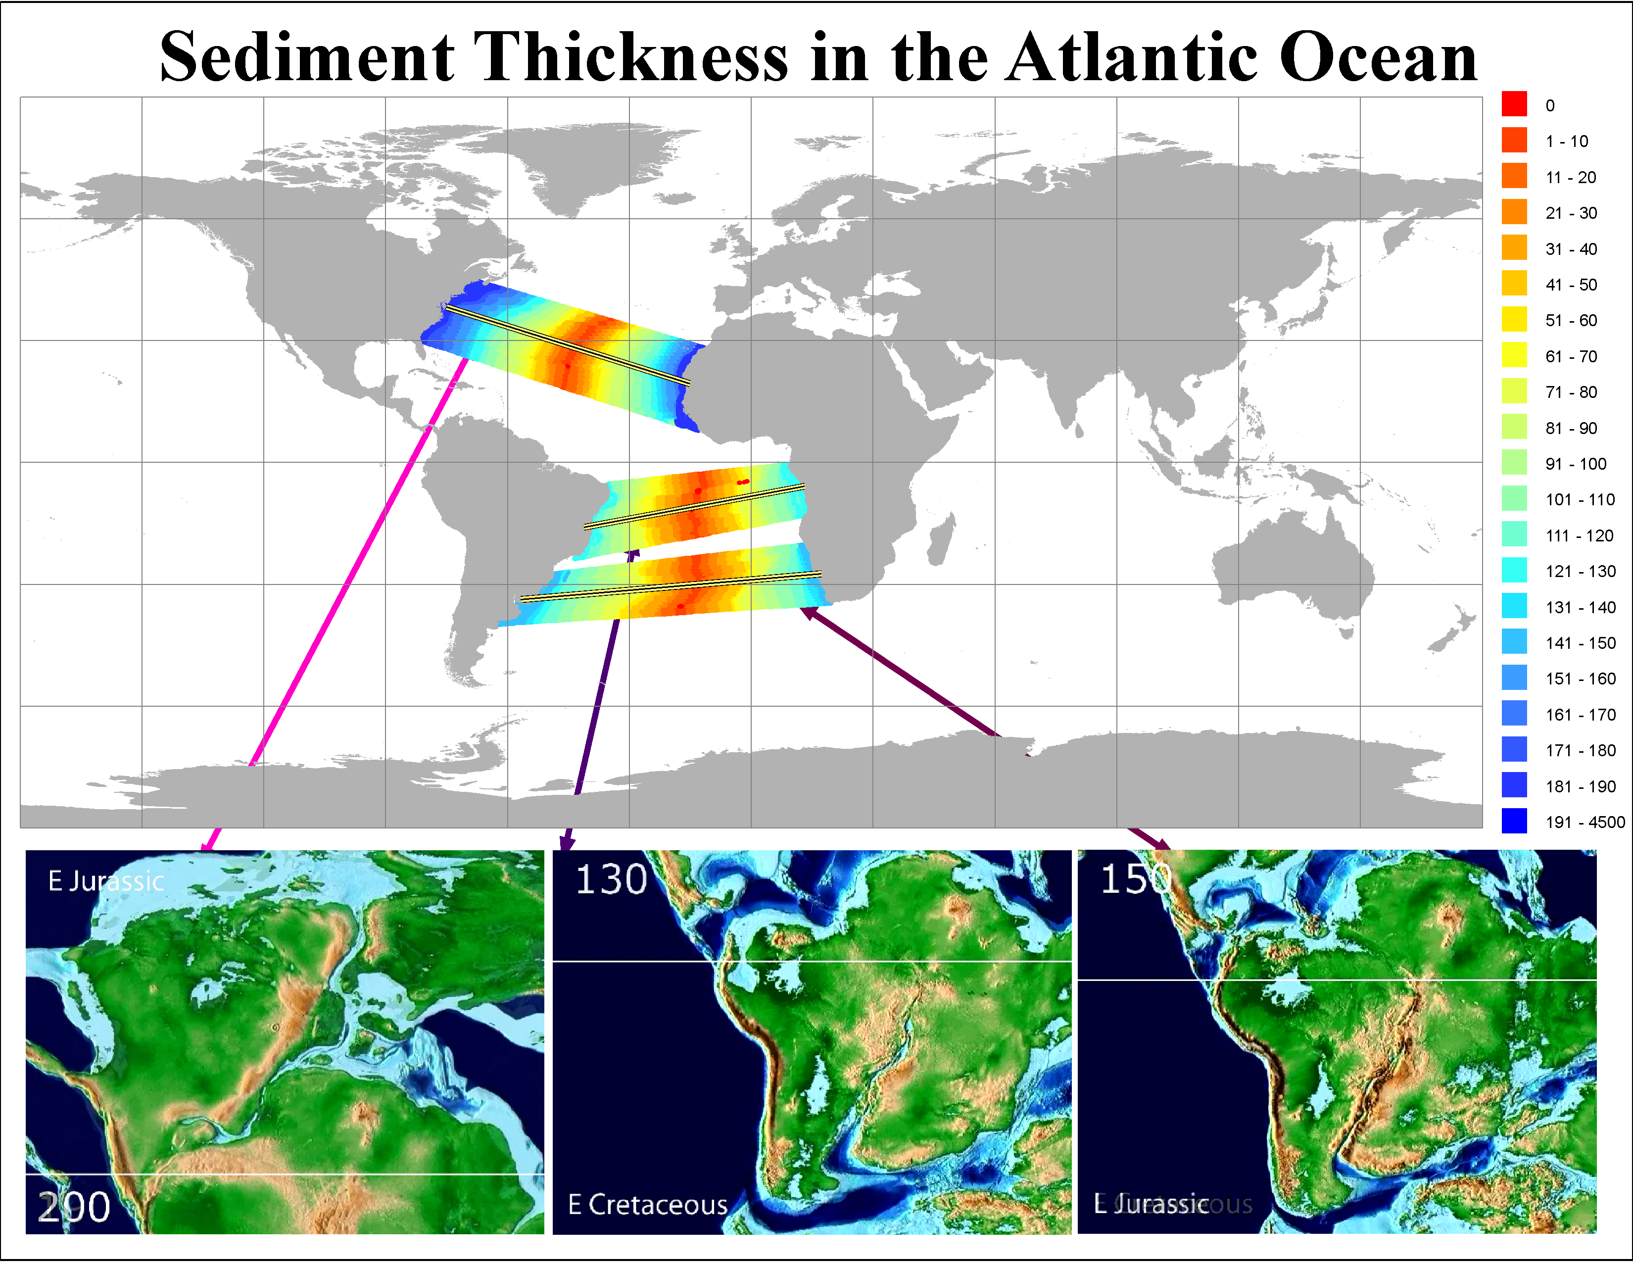

Slide 25
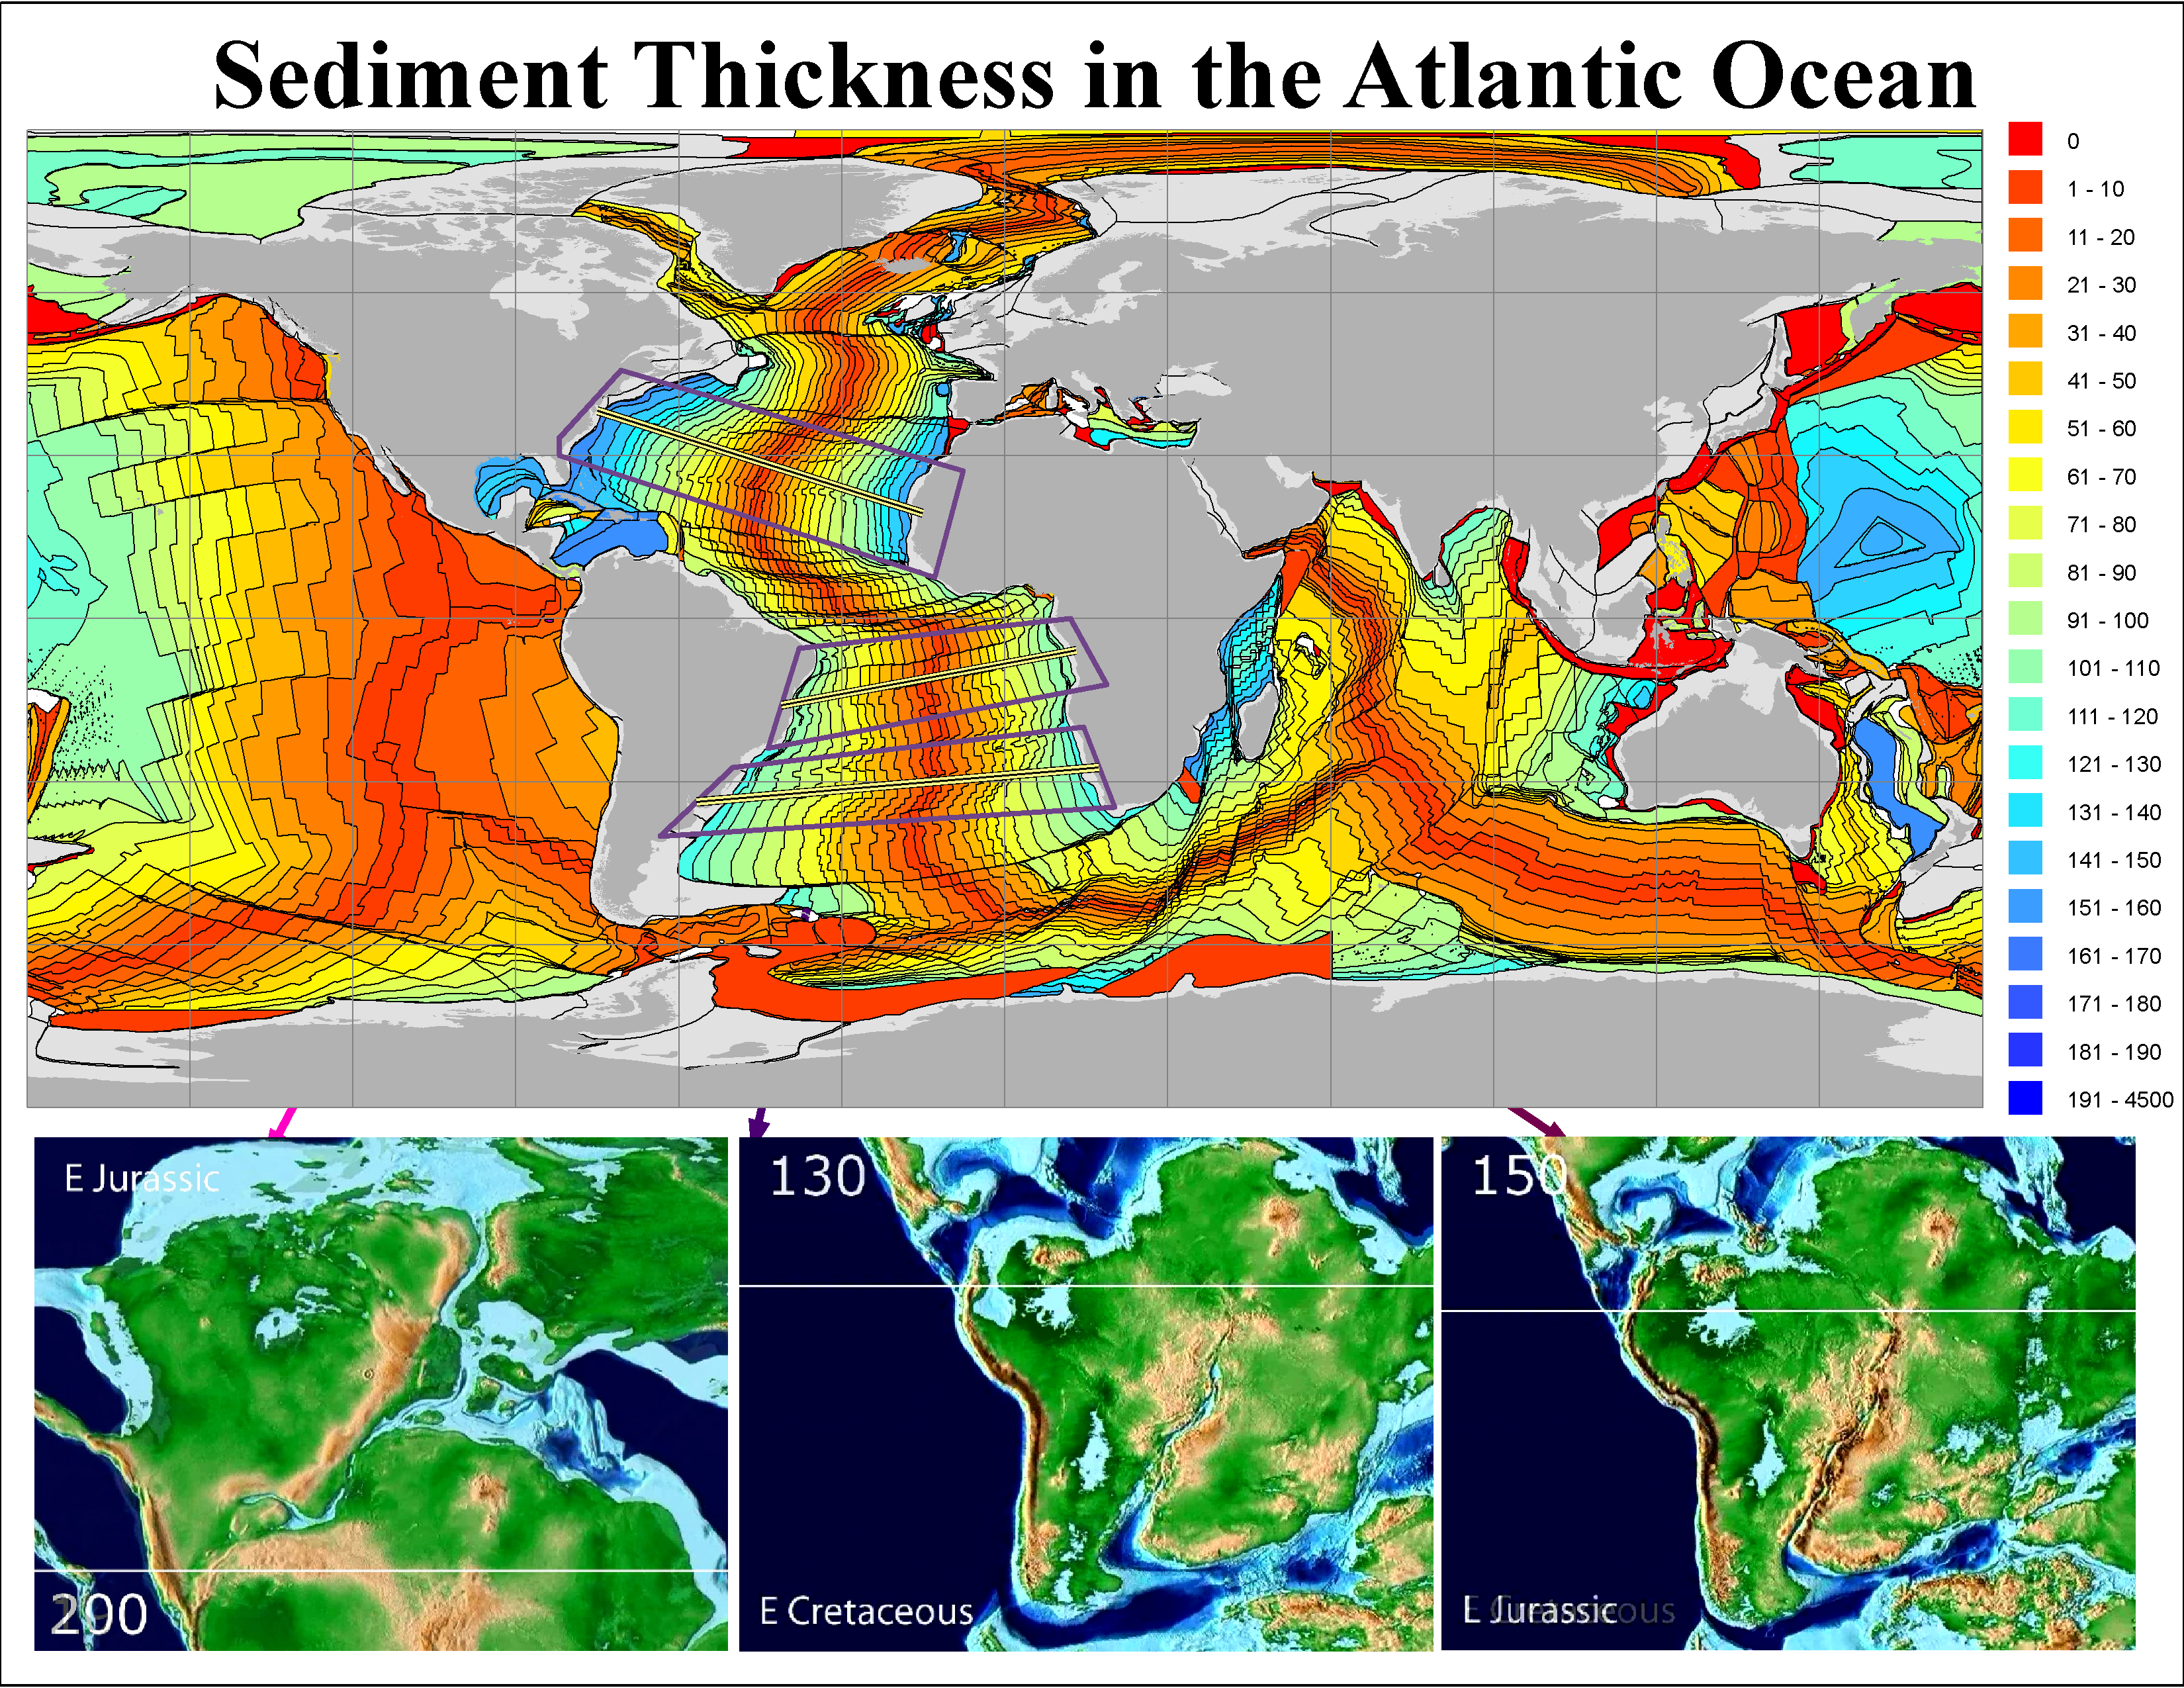

Slide 26
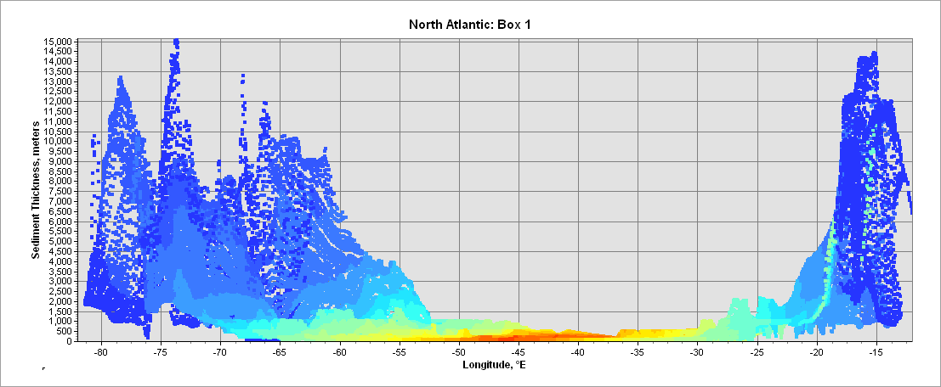
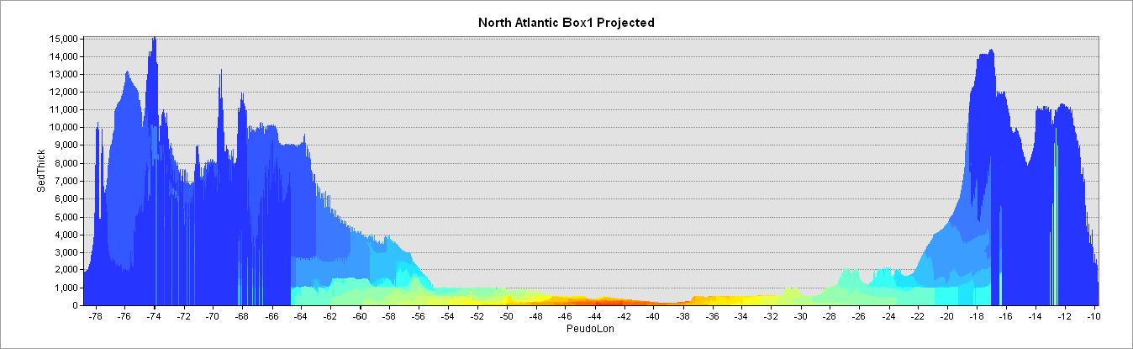

Slide 27
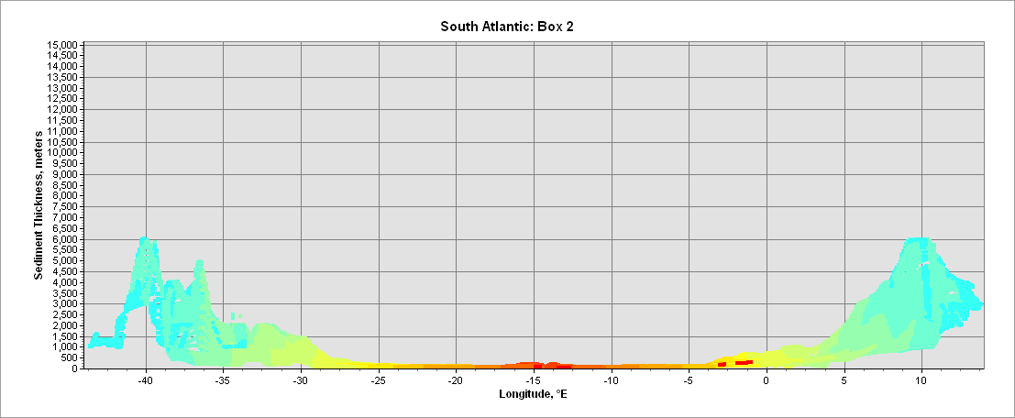
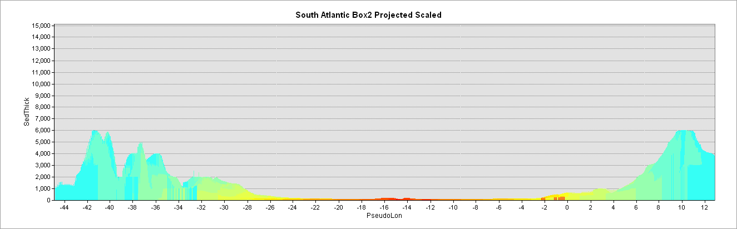

Slide 28
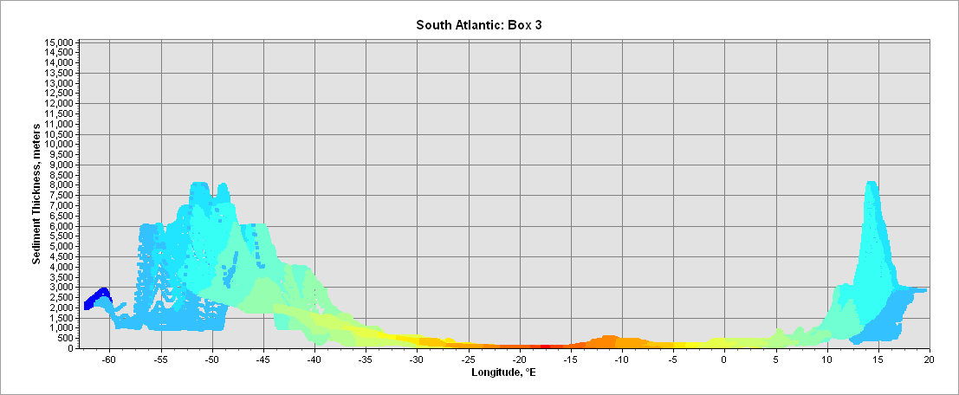
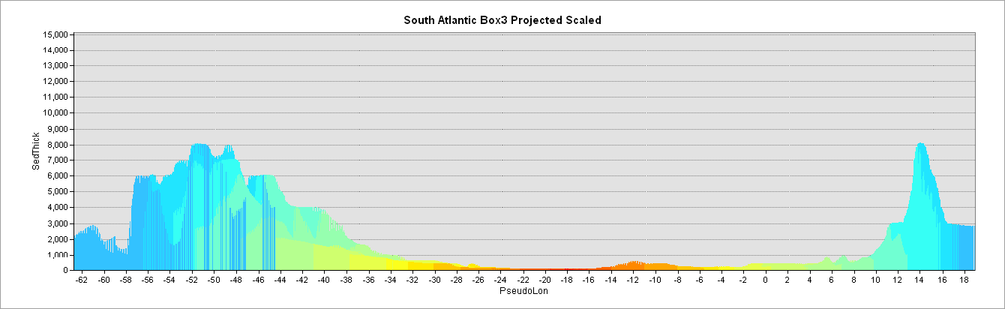

Slide 29
